Slide 1
IHS Resource Development Meeting
December 8, 2020
A think-tank approach to discussing ongoing grant opportunities, best practices for grant preparation and interfacing with Grantmakers during application.

Slide 2
A Streamlined Effort
STEUBEN RESOURCE DEVELOPMENT GROUP
C-RED
Chemung Resource Development
IHS PRD & Member Services
Consultations
IHS Resource Development Group

Slide 3
How Services Are Evolving
We will no longer offer start to finish grant writing services
What does that mean?
Why are we changing service models?
Why will this result in better service?

Slide 4
What Services Will Continue?
NEARLY EVERYTHING!
RESEARCH & WRITING DRAFTING PROGRAM RFPs DEMOGRAPHICS & STATISTICAL RESEARCH REVIVED PROGRAM EVALUATION OPTIONS (COMING SOON!) REVIEW OR WRITTEN GRANT PROPOSALS | PLANNING & POSITIONING YOUR ORGANIZATION FOR FUNDER REQUIREMENTS LINKING YOUR ORGANIZATION TO PROFESSIONAL DEVELOPMENT OPPORTUNITIES REVIEW OF ANY ORGANIZATION MATERIALS (ANNUAL REPORTS, WEBSITES, NEWSLETTERS, BROCHURES, AND ETC.) PAIRING ORGANIZATIONS FOR COLLABORATIVE EFFORTS

Slide 5
Basic Terms of Service
OUR RESPONSIBILITIES | USER RESPONSIBILITIES
To lead meetings bi-monthly; | To make requests for specific grant opportunities the applicant qualifies for;
To fulfill user requests in a timely manner; | To supply agency information to the grant writer upon request;
To issue a monthly update of opportunities; | Agrees to be invoiced at the stated hourly rate for projects;
To invoice partners within the first 10 days of the month following billable activity. | Agrees to pay invoices within 30 days.
The rate of service is $65/hour. Time may be capped by the service user.
An initial consultation/review of terms is free.
A full Memorandum of Understanding will be provided upon request of service.
There is no fee for referral to outside services, network providers set their own fees.

Slide 6
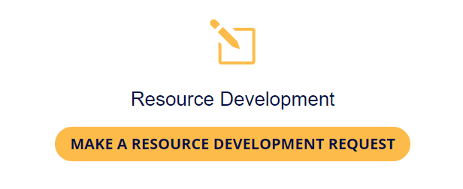
How to Make a Request
Four Easy Steps
Visit our website: www.ihsnet.org
Select Resource Development from the IHS Services List in the Navigation Menu
Click the Button “Make A Resource Development Request”
Fill in the Google Doc. and Submit it.

Slide 7
Why Consult with IHS?
Our History
– Since 1984 we’ve facilitated the needs of nonprofit members and governmental agency partners.
Our Track Record
– In the last 20 years, we’ve helped secure tens-of-millions of dollars for clients.
2016: $1.3M, 2017: $945,333, 2018: $6.6M, 2019: $2.9M, 2020: TBD
Added Member Benefits
IHS members can access reduced GrantStation membership and NYCON resources.
Our Ability to Scale to Your Needs
– We’re building a network of professionals to supplement our services.

Slide 8
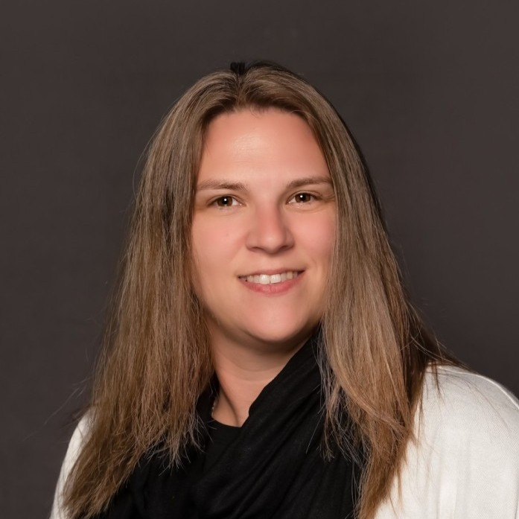
Ostrander's Consulting is an Elmira-based firm focused on helping guide and assist businesses and communities in generating economic growth and revitalization efforts.
With more than 30 years of combined experience, they also have working relationships with the region's nonprofit community.
Link to Additional Resource
Nichola Ostrander
Owner, Consultant
Ostrander’s Consulting, Certified MWBE
nostrander@ostrandersconsulting.com

Slide 9
Any Follow Up Questions?

Slide 10
White Board Session
What are your
greatest areas of need?

Slide 11
What We’re Hearing
HOMELESSNESS
Money for Shelter Space
Subsidized Housing
WORKFORCE DEVELOPMENT
On the Job Training
Continuing Education
COVID-19 Relief
Operational Support
PPE Needs
Navigating Federal Programs
Other Human Services
Food Security
Healthcare Delivery
Rural Transit
Child & Family Services
Emerging Opportunities Trending in 2021:
Criminal Justice Reform, Mental Health Services and Telemedicine

Slide 12
Current Opportunities
Stay up to date with our monthly newsletter.
Features:
Group-related News Items
Recently Announced Opportunities
Training & Professional Development Events
Meeting Dates, Times, Recordings and Notes
*Sent after each meeting has concluded

Slide 13
Open Forum
Questions or Problems
with Ongoing Applications?

Slide 14
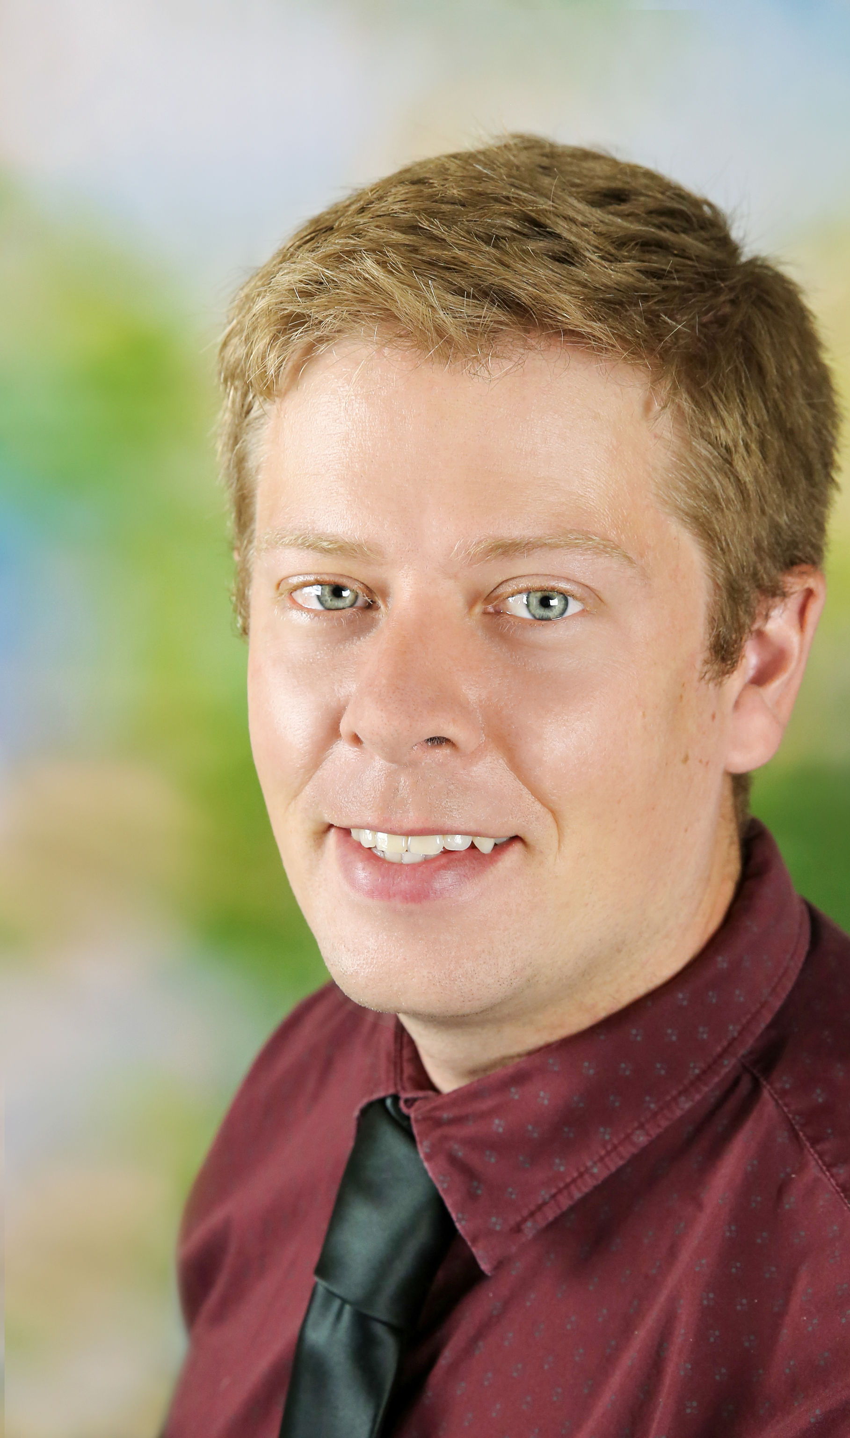
Recap, Questions & Comments
We’re Here for You!
We hope to provide opportunities for:
Briefings from and referrals to vetted grant-writing and administration professionals.
Quick notification of new and relevant funding opportunities.
The latest resource development updates in a monthly newsletter.
Review of applications and planning.
Top-notch resource development training.
And priceless opportunities to collaborate with a network of nonprofit and human services professionals
Jason Jordan
Director of Communications & Member Services jordanj@ihsnet.org
607-776-9467 ext. 231

